Slide 1
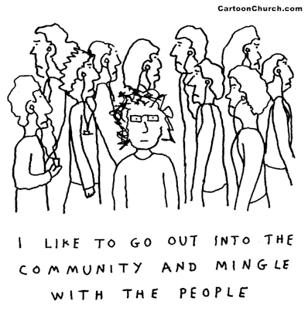
Leveraging Emerging Social Web Trends for Marketing Ravish Kamath SiliconIndia – Marketing Symposium 4th February, 2011
1

Slide 2
The Rise of Social Media Trends that are making us re-think
Facebook added 100M users in 9 months. Other media to reach 50M…
Facebook would be 3rd largest country (500M….and growing)
China: 1B, India: 1B, Facebook: 500M, US: 300M…Twitter: 175M
More Videos uploaded on YouTube in 60 days than all 3 major US Networks created in 60 years
Facebook and Twitter role in Iran Elections (2009 - 2010), Tunisia & Egypt (2011)
38 years 3 years 4 years

Slide 3
Some Key Emerging Trends
1
Businesses will find ROI
Social Equity will get established
Social Ecosystem will drive innovation
Businesses will happen elsewhere
2
3
4

Slide 4
BUSINESSES WILL FIND ROI What ROI means for different functions ?
1
Establish brand presence (Corporate Marketing)
Establish thought leadership (Product Marketing)
Enhance product support (Customer Support)
Enhance reputation (Public Relations)
Customer & prospect nurturing (Inside Sales)
Increase website traffic (Marketing)
Lead generation and sales (Marketing, Sales)
Employee acquisition & retention (Human Resources)
Business Intelligence & Research (Market Research)
Reseller & Partner Management (Channel Marketing)

Slide 5
BUSINESSES WILL FIND ROI Consumer’s need balance
1
Social Media clutter
80% of Gen Y are joining and they have an average of 220 friends
Check-In’s, Deals, Sweepstakes, Loyalty Programs & More…
Marketers jostle for attention
60% of marketers are already using paid or created social media
25% plan to within next 12 months
Only one in six companies will be absent from social channels by 2013
Privacy Concerns
Privacy concerns have grown from 30% to 36%
Users are less likely to click on “Like” button or allow applications to share social media
Signal to Noise Ratio is very bad

Slide 6
BUSINESSES WILL FIND ROI What businesses need to do ?
1
Presence IS NO MORE Social Media Strategy
Businesses will need to bring in CREATIVITY and DIFFERENTIATION
Businesses will need to be TRANSPARENT
Rise above the NOISE

Slide 7
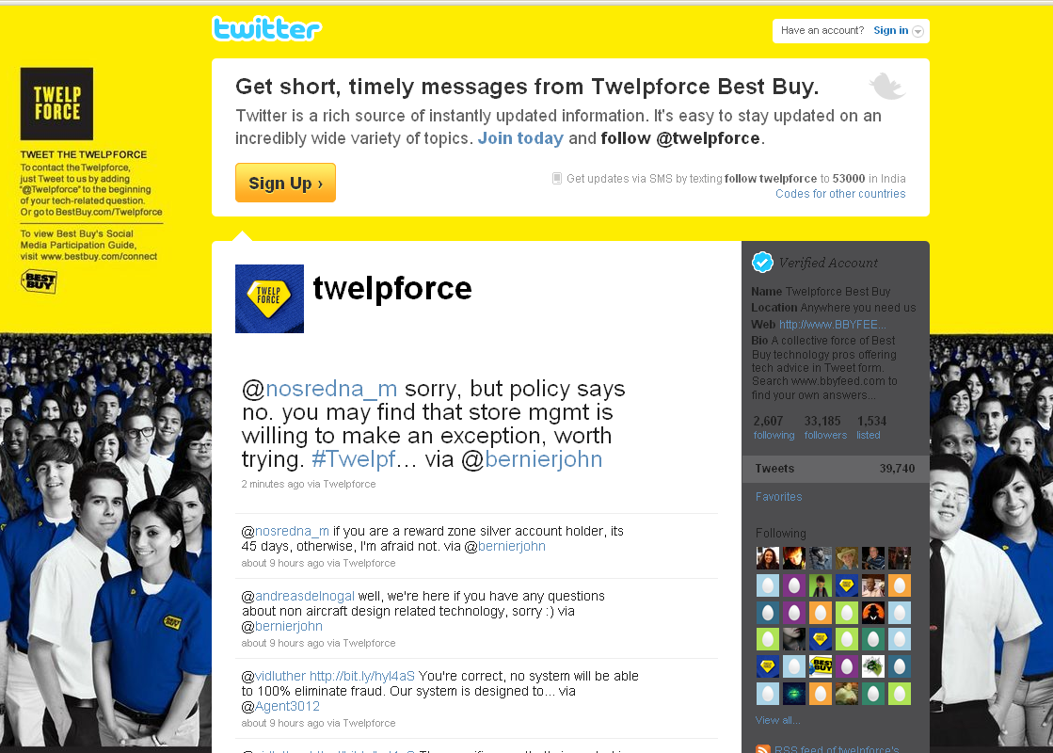
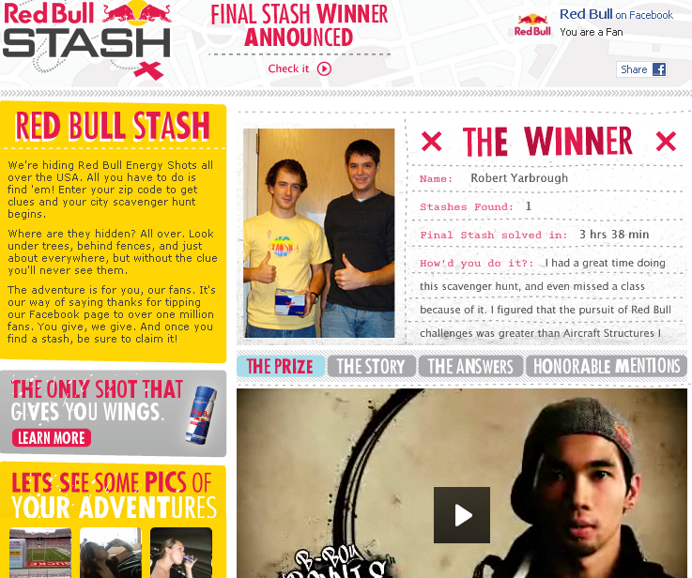
BUSINESSES WILL FIND ROI What businesses need to do – Some Examples
1
BestBuy combated online retailers with Twelpforce (twitter help force)
Red bull stash contest in US
City based Scavenger hunt
15 million likes on Facebook

Slide 8
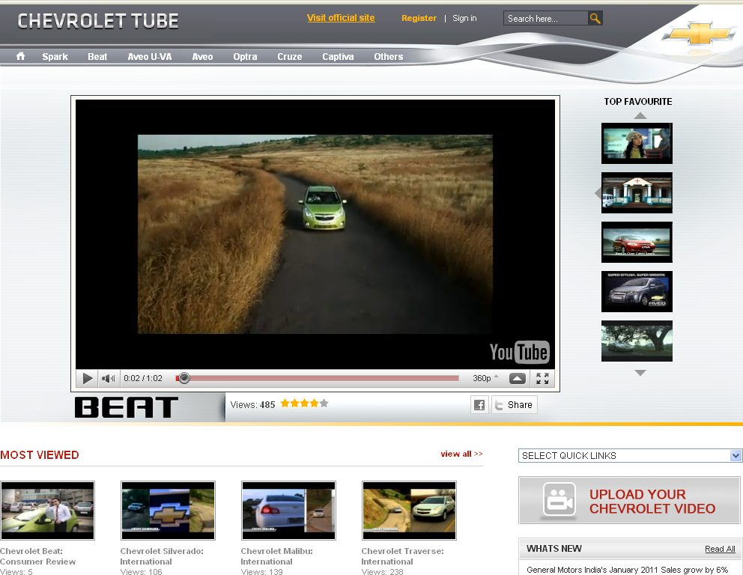
BUSINESSES WILL FIND ROI What businesses need to do – Some Examples
1
Chevrolet’s India focused YouTube channel

Slide 9
BUSINESSES WILL FIND ROI What businesses need to do – Some Examples
1
Chevrolet’s India focused YouTube channel
Walmart’s CrowdSaver facebook app

Slide 10
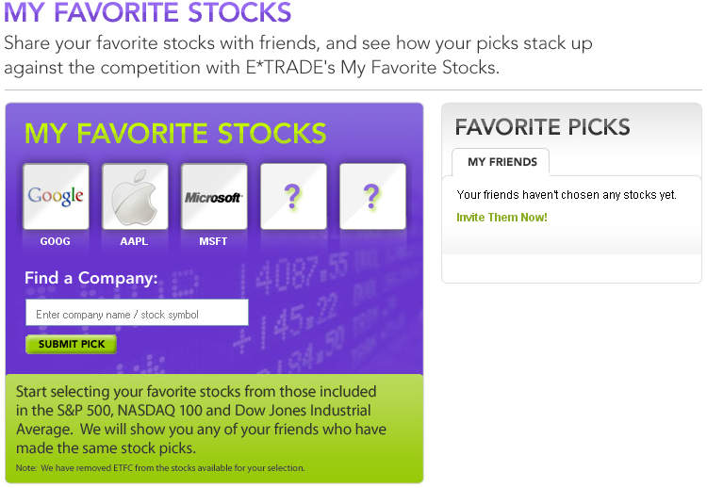
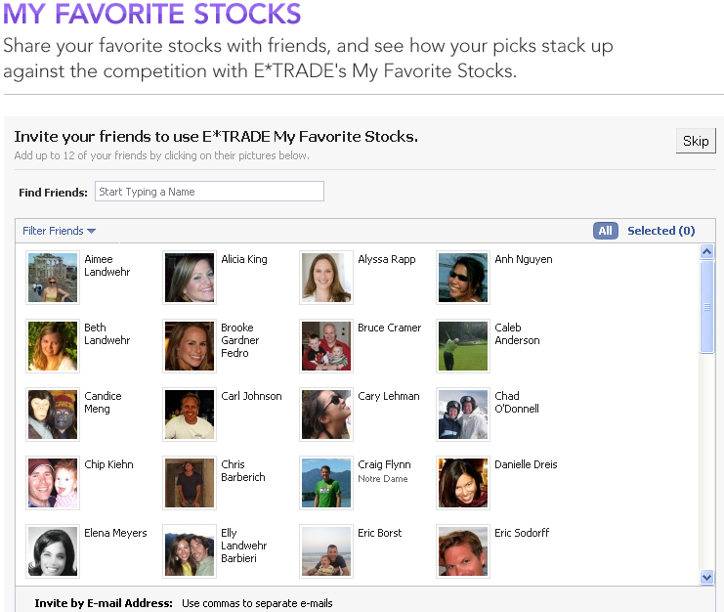
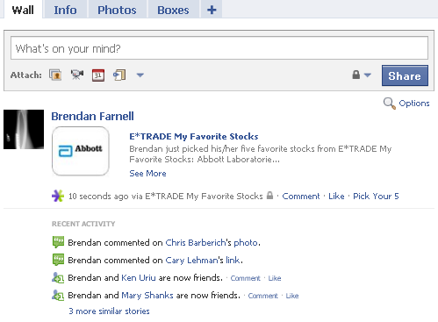
BUSINESSES WILL FIND ROI What businesses need to do – Some Examples
1

Slide 11
BUSINESSES WILL FIND ROI BUT Measuring Social Media KPI will be ?
1
Easier
Difficult
Brand awareness
Business outcome
Website traffic
Product feedback
Prospect lead volume
Prospect engagement
Lead Quality

Slide 12
SOCIAL EQUITY WILL GET ESTABLISHED
2
Social Equity
Affiliation
Advocacy
Information
Identity
Conversation
Utility

Slide 13
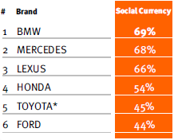
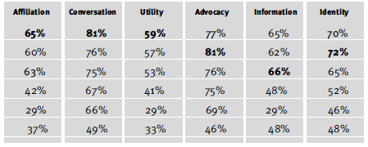
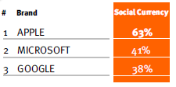
SOCIAL EQUITY WILL GET ESTABLISHED
2

Slide 14
SOCIAL ECOSYSTEM WILL DRIVE INNOVATION
3
Crowd-sourcing for Innovation – Practice of sourcing ideas
From Whom ?
Public
Partners
Customers

Slide 15
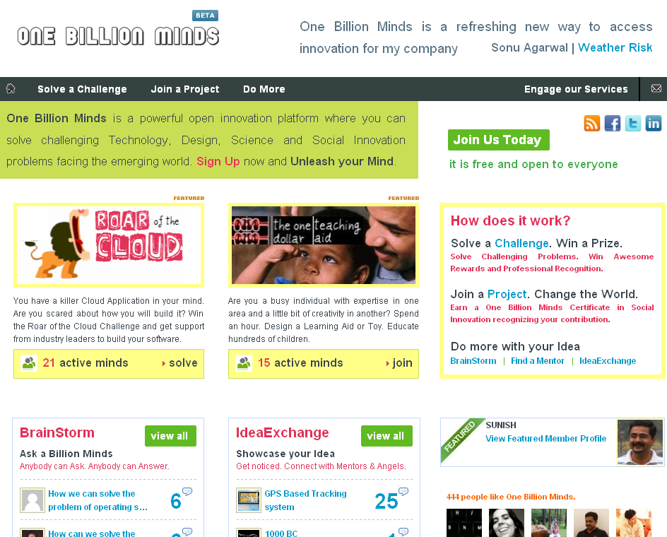
SOCIAL ECOSYSTEM WILL DRIVE INNOVATION
3

Slide 16
SOCIAL ECOSYSTEM WILL DRIVE INNOVATION
3

Slide 17
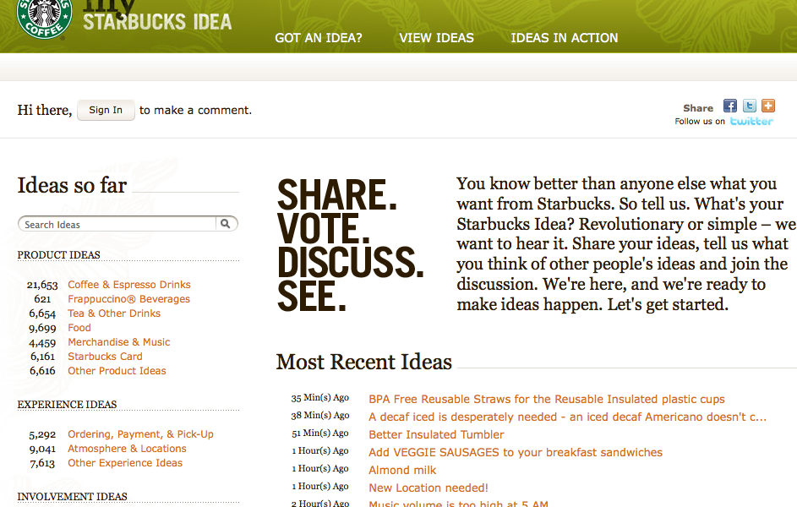
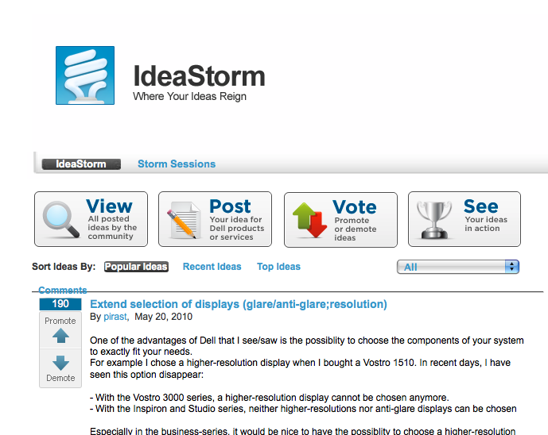
SOCIAL ECOSYSTEM WILL DRIVE INNOVATION Some Retail Examples
3
StarBucks Idea
63000 Product ideas
25000 Experience ideas
15000 Involvement ideas
Dell Ideastorm
15000 ideas contributed
431 ideas implemented

Slide 18
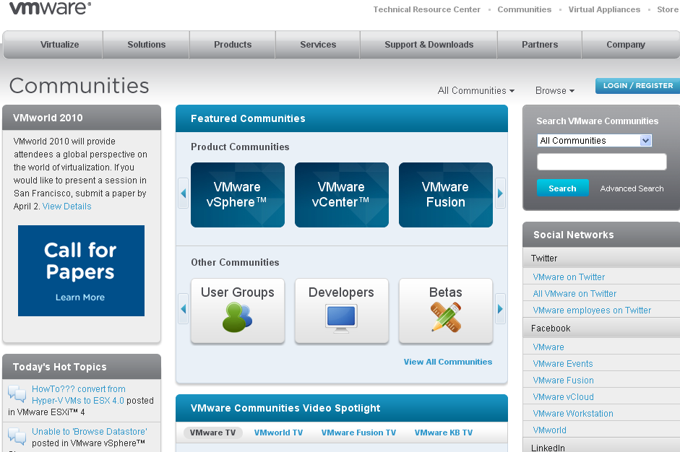
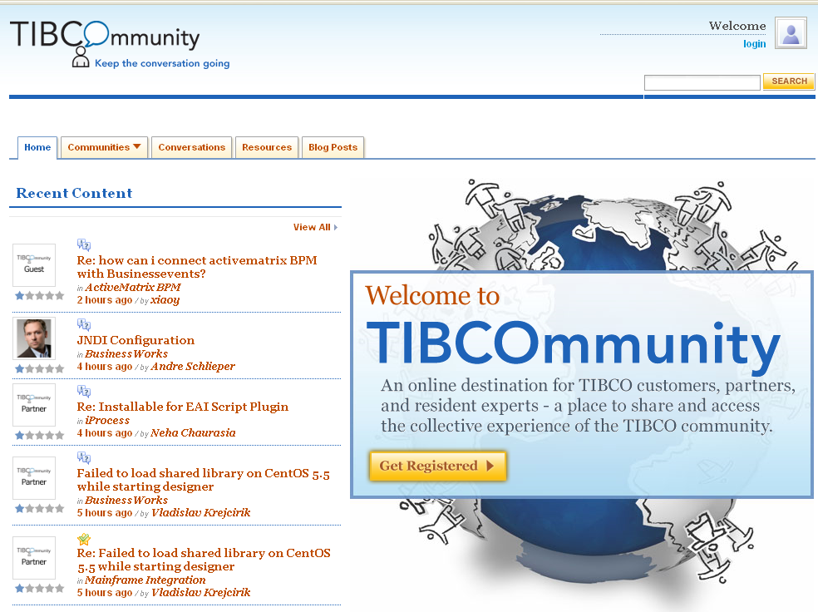
SOCIAL ECOSYSTEM WILL DRIVE INNOVATION Some Enterprise Examples
3
VMWare product communities
Extended Quality Control Team
Product feedback / suggestions
Tibcommunity
First line of product support

Slide 19
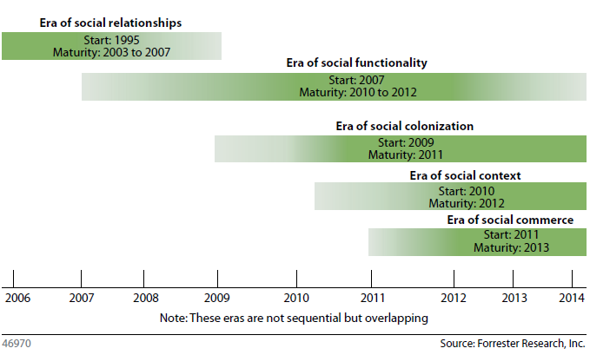
BUSINESSES WILL HAPPEN ELSEWHERE Establishing the Five Eras of Social Web
4
Era of Social Relationships – Simple profiles & friend-ing features
Era of Social Functionality – Supports Interactive applications
Era of Social Colonization – Traverse the internet with social connections
Era of Social Context – Identify personal identities and relationships
Era of Social Commerce – More powerful than Websites & CRM Systems

Slide 20
BUSINESSES WILL HAPPEN ELSEWHERE So what is expected ?
4
Consumers will strengthen external communities
Power will shift from Brands and CRM Systems
E-commerce sites will adopt Social Graphs rapidly (to catch up !)
Birth of Social Recommendation Engine
“Recommended for you..” TO “John says you will like this…”

Slide 21
BUSINESSES WILL HAPPEN ELSEWHERE E-commerce on Facebook
4

Slide 22
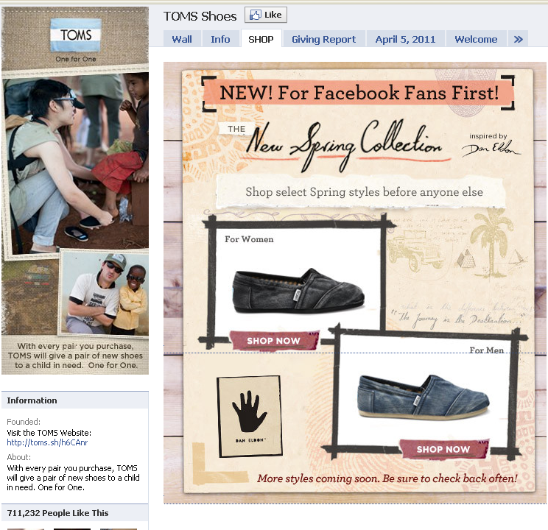
BUSINESSES WILL HAPPEN ELSEWHERE E-commerce on Facebook
4

Slide 23
Connect with me
LinkedIn - http://www.linkedin.com/in/ravishkamath
Twitter - @ravishkamath
Email – rkamath@regalix-inc.com

